Slide 1
AI that understands language: sort, search, translate and summarise
What can AI do with our messages, contracts and calls, in English and in our local languages?
Leading with AI | Session 4 of the 15 (Sessions 0 to 14)
KLAi Professional Learning | Jotham Martin Wambi
Notes:
Welcome back. In Session 3 we learned to judge a prediction: false alarms, misses, and the score on cases the system never saw. Today we turn to the largest pile of information most organisations hold, which is text: messages from customers, contracts, reports and recorded calls, in English and in our own languages.
The question is: what can AI do with them?
We start in a Ugandan legal library, build four language jobs one picture at a time, tour six industries, and watch a search find the right clause from a plain description. Then you add a pile of your own text to your portfolio.

Slide 2



Today in one view: what you will leave with
By the end of today you will have
Name the four jobs AI does with language, sort, search by meaning, translate and summarise, and say what each is good and bad at
Ask the questions that show whether a language tool will work on your text and in your languages
Add one or two piles of your own text to your AI Opportunity Portfolio, each with the job you would give it
Notes:
That question gives three things you will be able to do by the end. You will name the four jobs AI does with language, sort, search by meaning, translate and summarise, and say what each is good and bad at. You will hold the questions that show whether a tool will work on your text and in your languages.
And your portfolio will gain one or two piles of your own text, each with the job you would give it.

Slide 3

Your two hours: four language jobs, the industries,
a demonstration, then your own portfolio
I show recorded searches and one live translation. You add your own text to your portfolio.
Notes:
Here is how the two hours run. Ten minutes to recall Session 3 and meet today’s question. Forty minutes on the four language jobs, one picture at a time, then six industries and three real cases. Fifteen minutes of demonstration: recorded searches, then one translation done live. A five-minute break.
Ten minutes on your people and the questions to ask. Then twenty-five minutes on your own portfolio, five on your decision and ten to close. First, how today fits, and five words.

Slide 4

Three questions from last time
1. In Session 3, what are the two ways a prediction can be wrong?
2. Why can “95% accurate” be useless?
3. Which score should you ask a vendor for first?
Answer aloud first. Then we check together.
Notes:
Three quick questions from Session 3. Answer aloud first, and then we check together. It is a warm-up to bring last time back.
Question one. In Session 3, what are the two ways a prediction can be wrong? Take a moment.
A good answer is this. A false alarm: it flags a case that was fine. A miss: it lets through a case it should have caught.
Question two. Why can “95% accurate” be useless? Say it to yourself first.
A good answer is this. When the event is rare, a system that always says “no” scores high and catches nothing.
Question three. Which score should you ask a vendor for first? Think about your own work as you answer.
A good answer is this. The score on cases the system never saw, and what each kind of mistake costs.
If an answer was missing, last session’s take-away sheet or workbook page has it. Now to today.

Slide 5
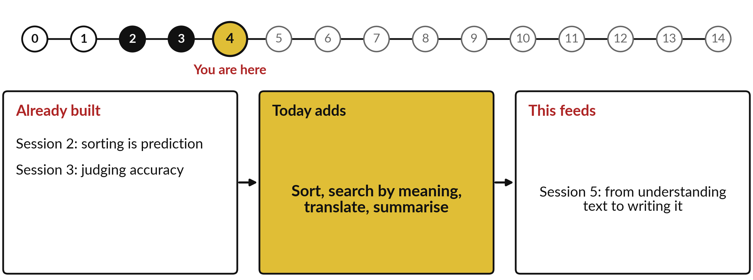
How today connects: what we
already have and what it feeds
Each session is built on the ones before it.
Notes:
So where does today sit in the story? The dots along the top are the fifteen sessions, from the map at Session 0 to your plan at Session 14, and the gold one is today.
We already hold sorting is prediction from Session 2 and judging accuracy from Session 3. Nothing today starts from zero.
What today adds is this: sort, search by meaning, translate, summarise.
And it feeds straight into what comes next. Session 5: from understanding text to writing it. Keep that chain in mind, because each idea you learn today is a step on it.

Slide 6




Words we use today
Word | What it means
Classification | Sorting each message into one of a few labels, such as order, payment or complaint.
Semantic search | Search by meaning: finding the passage that means the same thing, even in different words.
Embedding | A text’s position on a map of meaning, worked out by a model. Close positions mean close meanings.
Machine translation | AI that turns text in one language into text in another.
Low-resource language | A language with little written text online for AI to learn from, as with most Ugandan languages.
Notes:
Five words for today. I give the plain meaning of each, and we use every one of them before the end of the session.
Classification. Sorting each message into one of a few labels, such as order, payment or complaint.
Semantic search. Search by meaning: finding the passage that means the same thing, even in different words.
Embedding. A text’s position on a map of meaning, worked out by a model. Close positions mean close meanings.
Machine translation. AI that turns text in one language into text in another.
Low-resource language. A language with little written text online for AI to learn from, as with most Ugandan languages.
Keep those words close. The first idea uses them straight away, so let us begin.

Slide 7
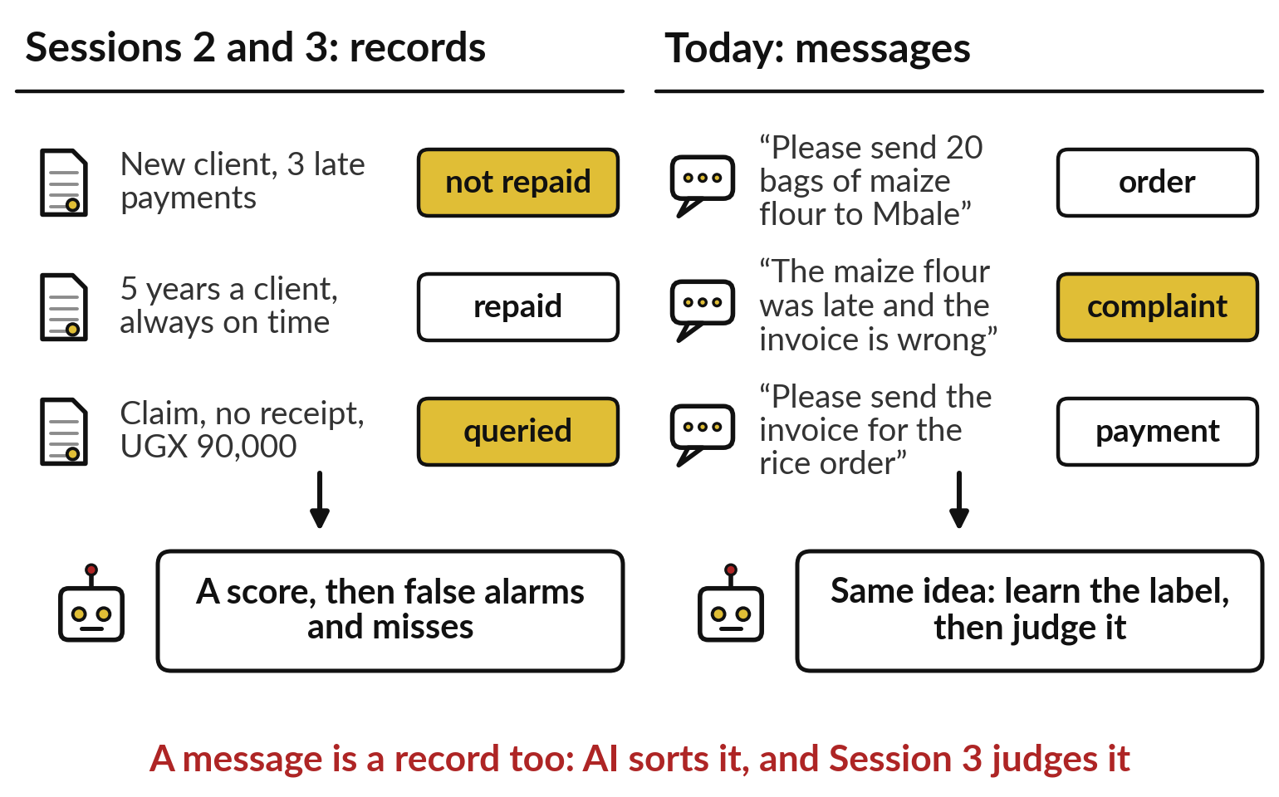
From Session 3 to today: a message is a
record too, sorted and judged the same way
Sorting messages is the prediction of Session 2, judged as in Session 3.
A record gets a label: repaid, queried.
A message gets one too: order, complaint.
False alarms and misses still apply.
Notes:
Those five words rest on what you already know. On the left are records from Sessions 2 and 3: a client, a claim, each with a label, a score, and the two ways of being wrong. On the right are three messages from shops to Nile Valley Foods, our fictional distributor.
Each can carry a label too: an order, a complaint, a payment. Sorting messages is the same learning from labelled examples, only the record is now text. And everything Session 3 taught still applies: a complaint filed as an order is a miss. So where does a pile of text become a leadership problem? In a Ugandan library.

Slide 8
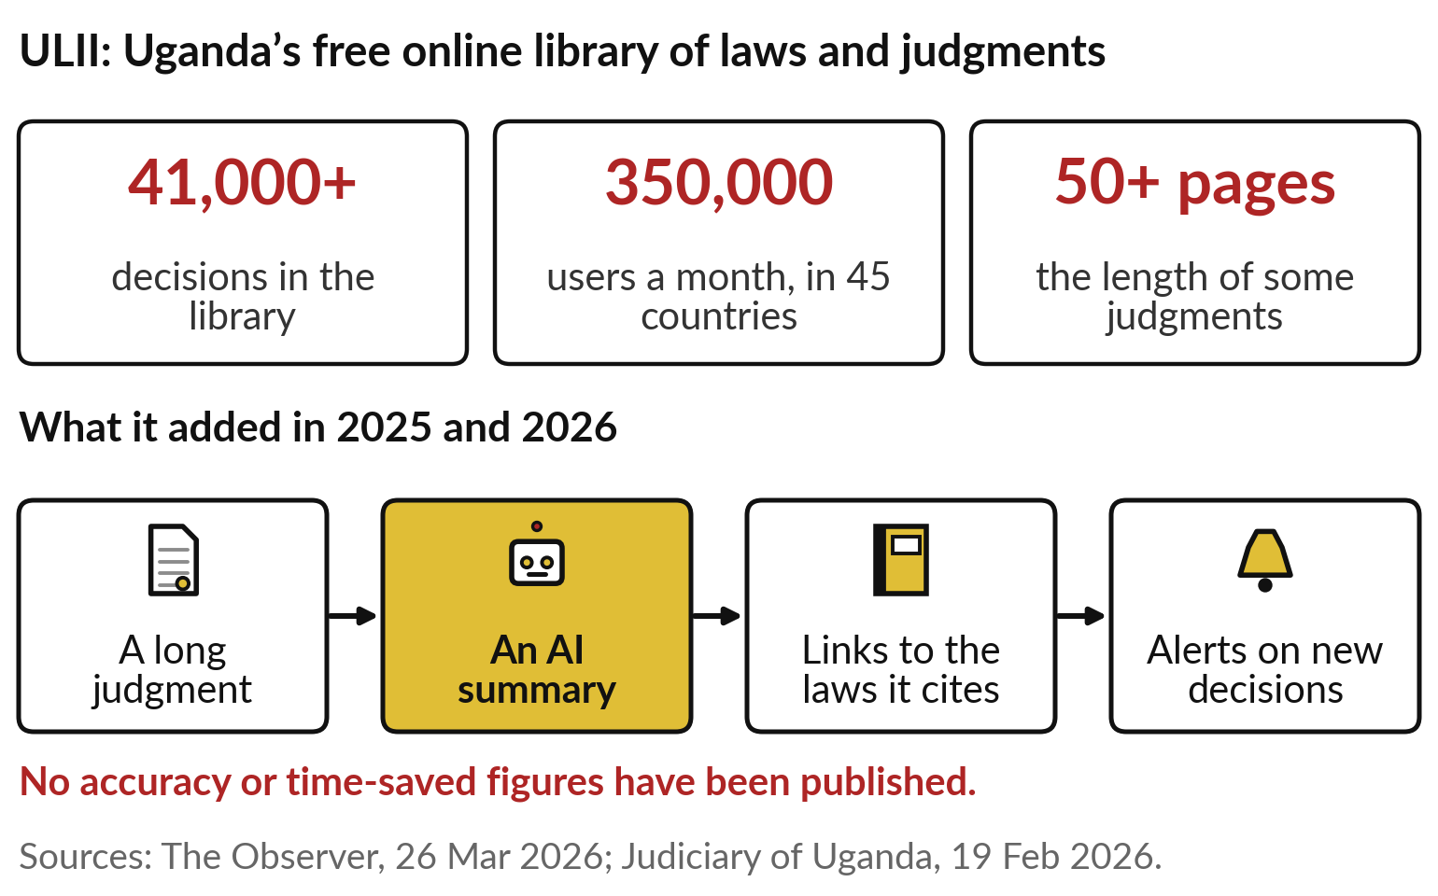
Kampala, 2026: ULII adds AI summaries to a library
of 41,000 court decisions few have time to read
Today’s question: what can AI do with our messages, contracts and calls?
A pile of text too large to read.
AI summarises, links and alerts.
Ask: how do we know the summary is right?
Notes:
The Uganda Legal Information Institute, ULII, is a free online library of our laws and judgments. It holds more than 41,000 decisions and serves about 350,000 users a month in 45 countries, and some judgments run past fifty pages. By early 2026 it had added AI summaries of long judgments, links to the laws and cases each one cites, and alerts on new decisions, and judges of the Commercial Division were trained to use them.
No accuracy figures have been published yet. Every organisation here has its own version of this pile: messages, contracts, reports and calls. What can AI do with ours?

Slide 9
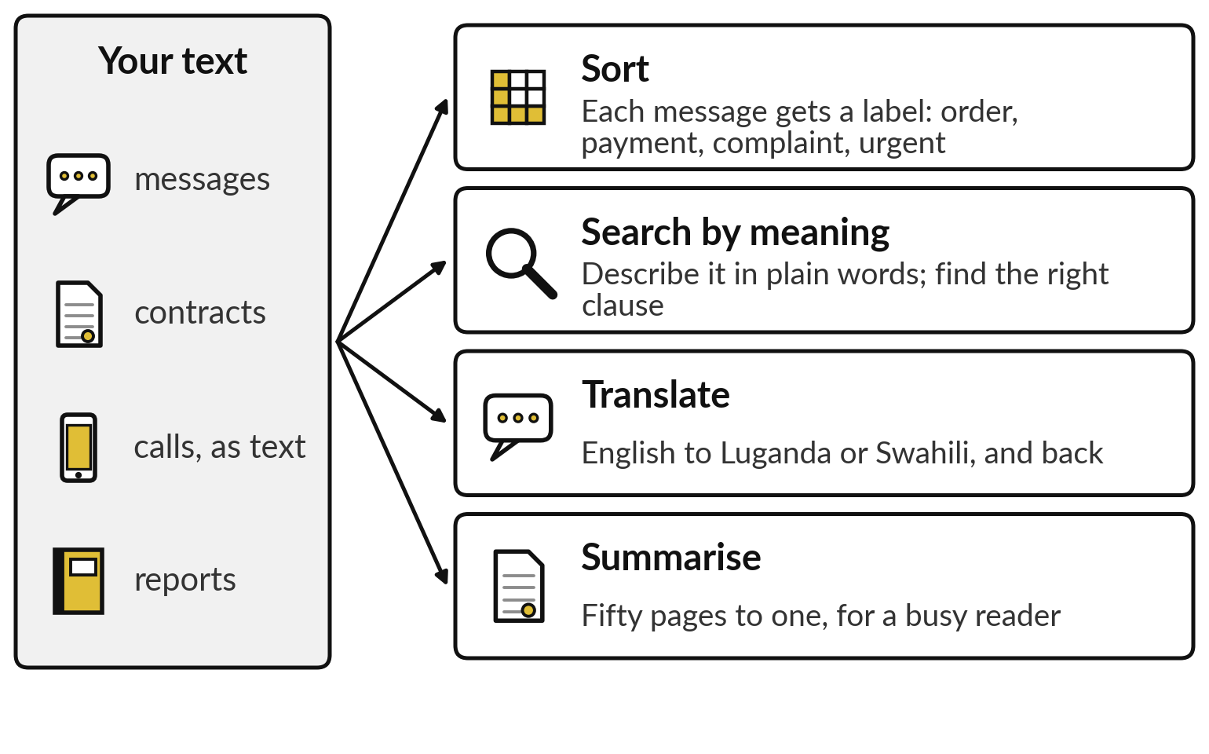
AI does four jobs with language: sort,
search by meaning, translate and summarise
One pile of text, four jobs.
Sort: a label on each message.
Search: find by meaning.
Translate, and summarise.
Notes:
Here is the whole idea in one picture. On the left is your text: customer messages, contracts, reports, and calls turned into text, as we saw in Session 1. AI does four jobs with it. It sorts, putting a label on each message, such as order, payment, complaint or urgent.
It searches by meaning, so you can describe what you want in plain words and find the right clause. It translates, from English to Luganda or Swahili and back. And it summarises, turning fifty pages into one for a busy reader. We take them one at a time, starting with sorting, because you already know how it works.

Slide 10
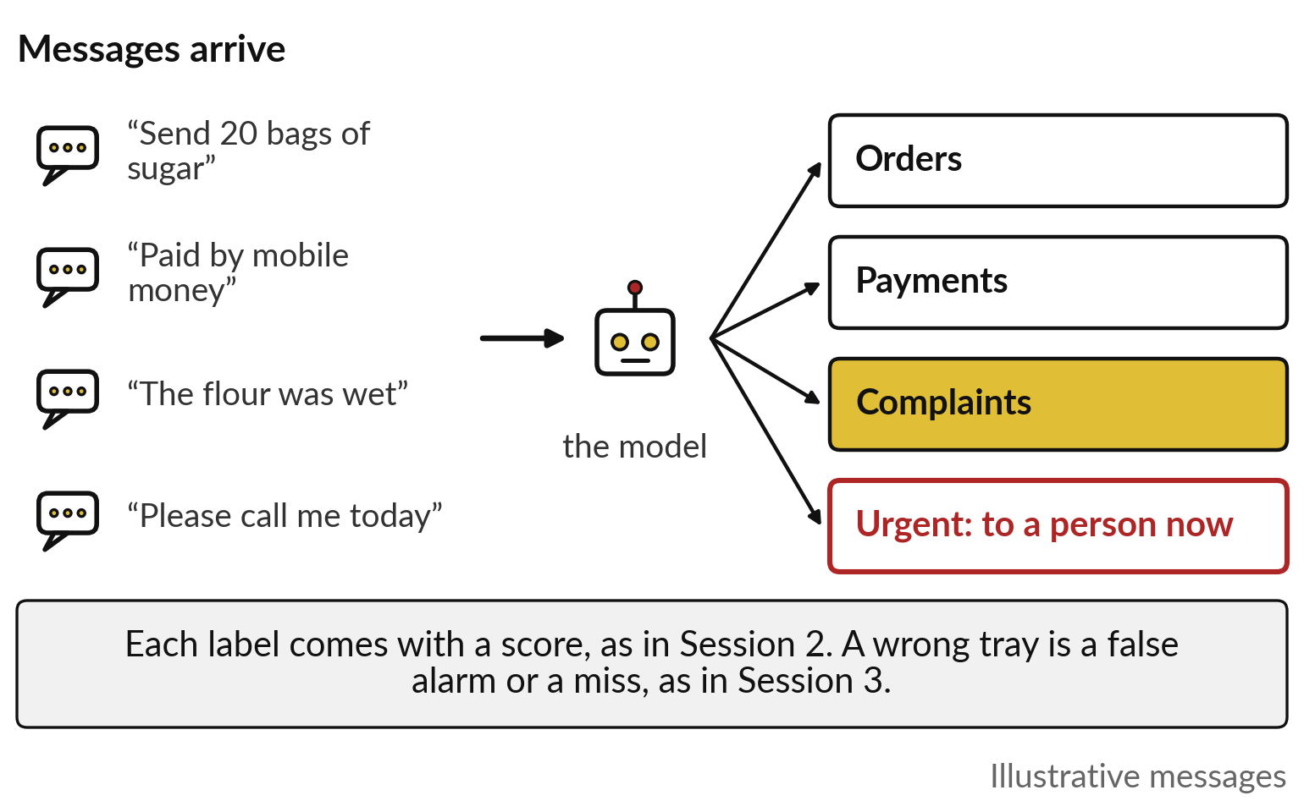
Sorting: each message gets a label and a
score, and the urgent ones go to a person
A model learns from past messages that people already sorted.
The industry calls this classification.
Labels: order, payment, complaint, urgent.
Judge it on messages it never saw.
Notes:
Sorting works exactly as prediction did in Session 2. People sort a few thousand past messages by hand: this one is an order, this a payment, this a complaint. A model learns from them, and then puts a label and a score on every new message as it arrives.
The industry calls this classification. Notice the red tray: urgent messages go straight to a person. And the Session 3 questions all apply. A complaint filed as an order is a miss, and an order flagged urgent is a false alarm. Sorting looks at the words in a message. But words alone can mislead, as a flood question shows.

Slide 11
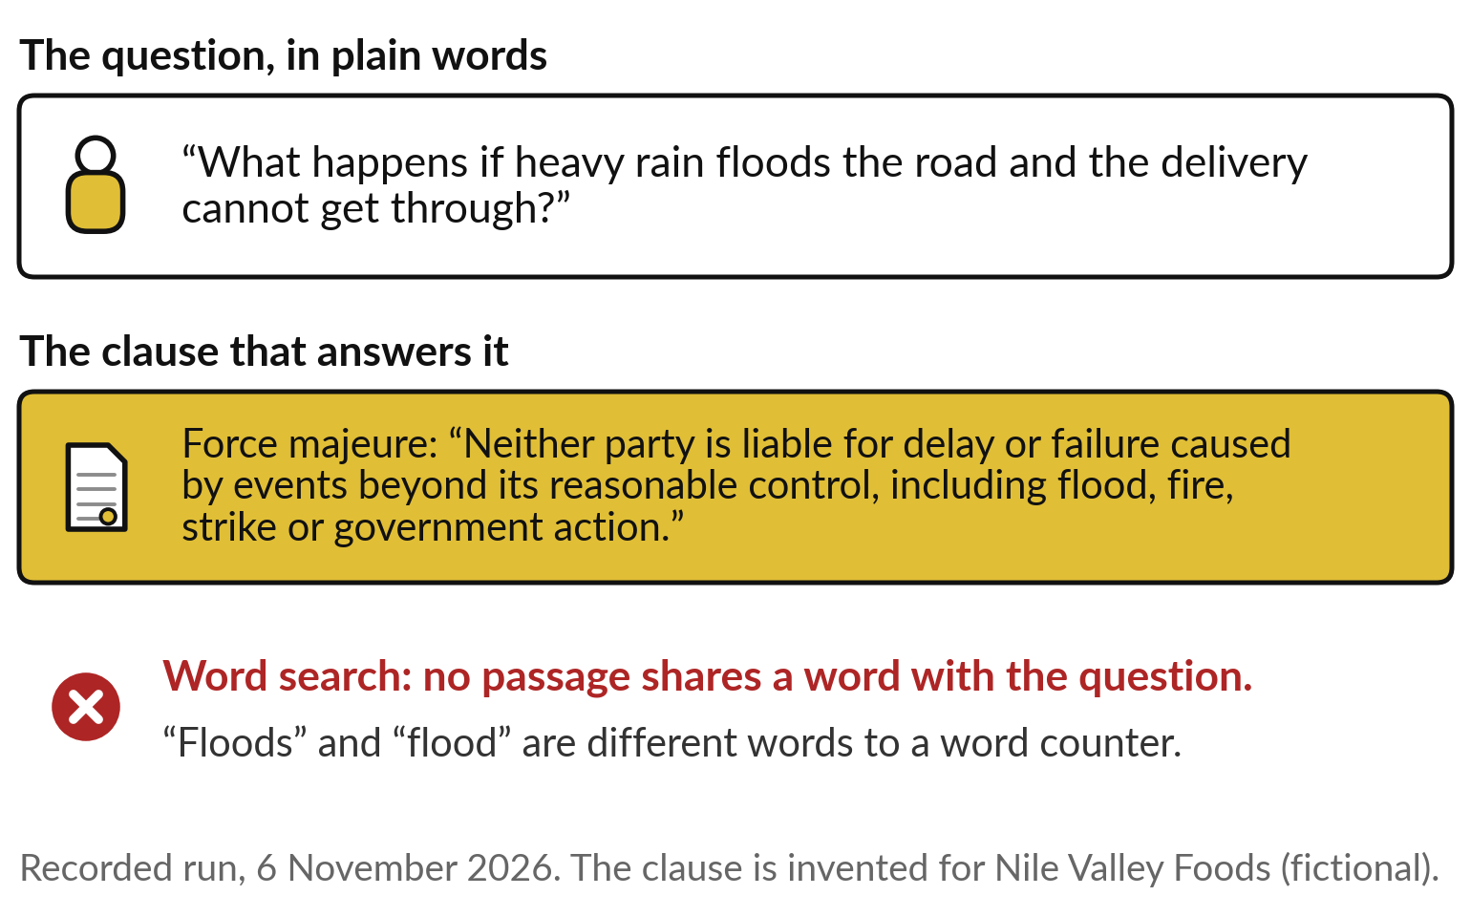
Matching words misses meaning: a flood question
and the force majeure clause share no word
People link rain, flood and road at once. A word counter does not.
Old search matches the same words.
Different words, same meaning: it fails.
Recorded on an invented contract.
Notes:
Here is the limit of matching words. A manager asks in plain words: what happens if heavy rain floods the road and the delivery cannot get through?
The clause that answers it is force majeure: no party is liable for delay caused by events beyond its control, including flood. You see the link at once. A search that matches words finds nothing, because the question and the clause share no word at all. Even floods and flood count as different words.
That is a recorded run on ten invented contract clauses. So how can a machine see that two texts mean the same thing?

Slide 12
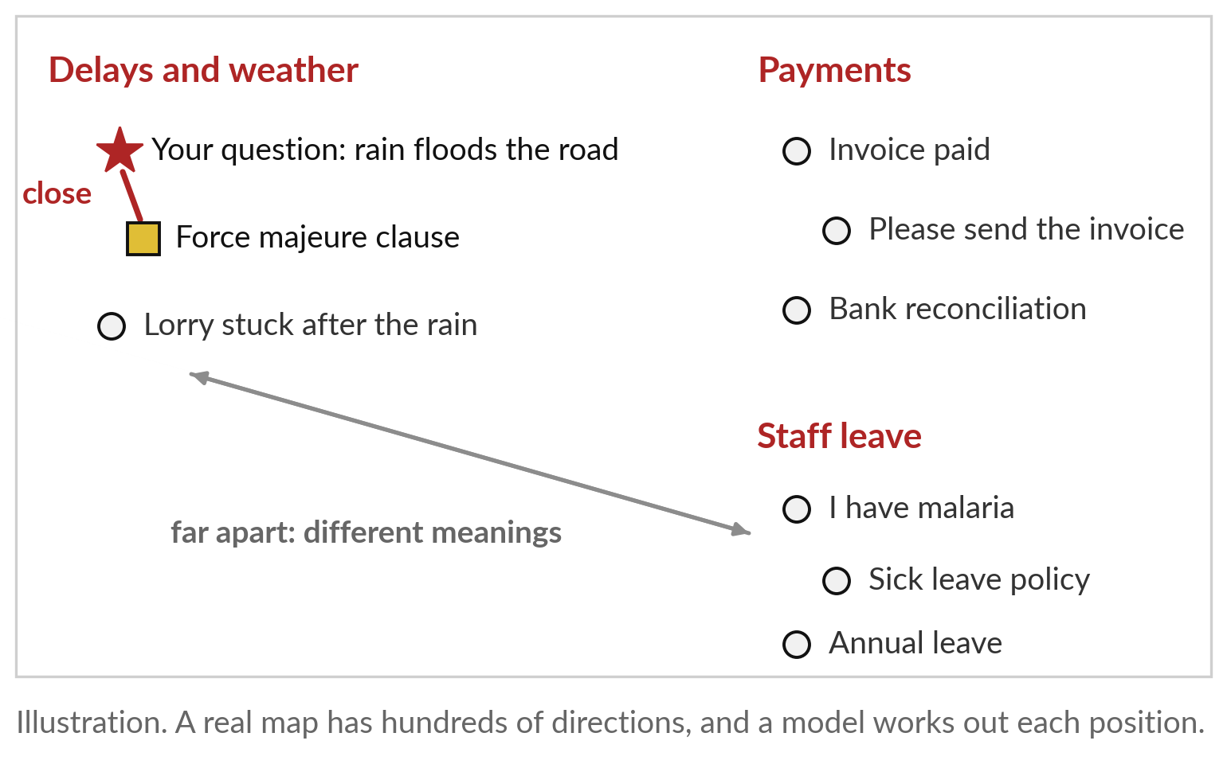
Meaning as closeness on a map: texts
that mean the same sit close together
A model places every text on a map. Close means similar in meaning.
Rain and force majeure land together.
Malaria and sick leave land together.
The position is called an embedding.
Notes:
Picture a map of meaning. A model, trained on a great deal of text, gives every sentence a position on it. Texts about delays and weather land in one corner, payments in another, staff leave in a third. Your flood question lands next to the force majeure clause, even though they share no word, and far from the sick leave policy.
The industry calls a text’s position on this map an embedding. This picture is an illustration with two directions; a real map has hundreds, and nobody reads the positions. We only ask one thing of them: which texts sit closest. That gives us a new kind of search.

Slide 13
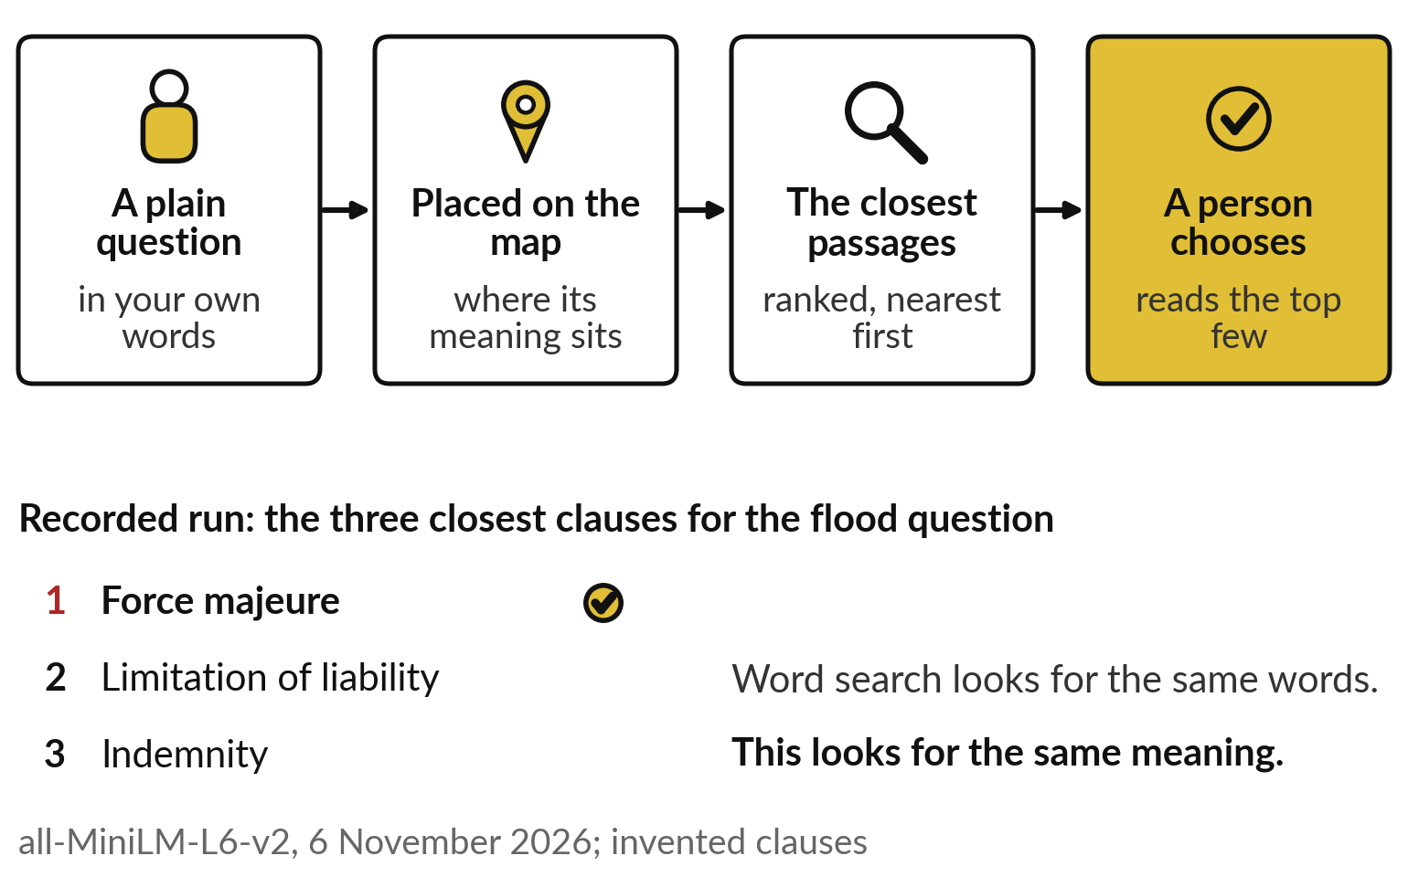
Search by meaning: describe what you want in
plain words, and get the closest passages first
Ask in your own words. It finds the nearest passages, and a person chooses.
The industry calls it semantic search.
It ranks the closest few.
A person reads them and chooses.
Notes:
Search by meaning follows directly from the map. You ask in your own words. The question is placed on the map, and the passages closest to it come back, nearest first. Then a person reads the top few and chooses. In our recorded run, the flood question brought back force majeure first, then limitation of liability, then indemnity.
The industry calls this semantic search, search by meaning. It is what lets staff ask a policy manual, a contract library or a knowledge base a question the way they would ask a colleague. Session 8 builds an assistant on it. The same map also helps with our third job.

Slide 14
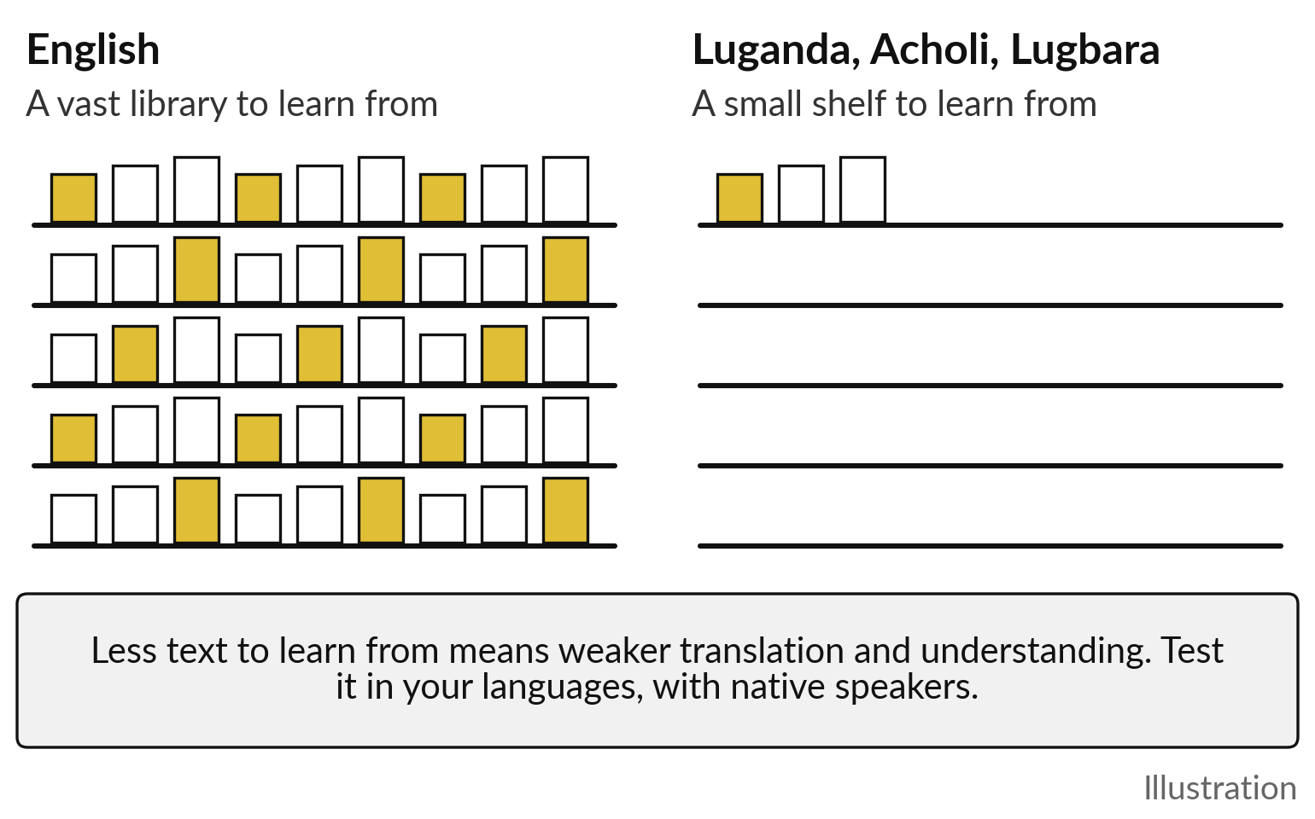
Translation follows the text a language has:
English has a library, most of our languages a shelf
Quality depends on how much written text the model learned from.
These are called low-resource languages.
Quality varies by language and topic.
Test with native speakers before use.
Notes:
Translation, which the industry calls machine translation, draws on the same learning: a model learns from huge amounts of text, including text written in two languages side by side. That is the problem for us. English has a vast library to learn from. Luganda, Acholi, Lugbara and most of our languages have a small shelf by comparison.
The industry calls them low-resource languages. So translation and understanding in them are weaker and vary by language and topic. A tool that reads English contracts well may stumble on a Lusoga voice note. The answer is to test in your own languages, with native speakers, before anyone relies on it. And Africans are building the shelf.

Slide 15
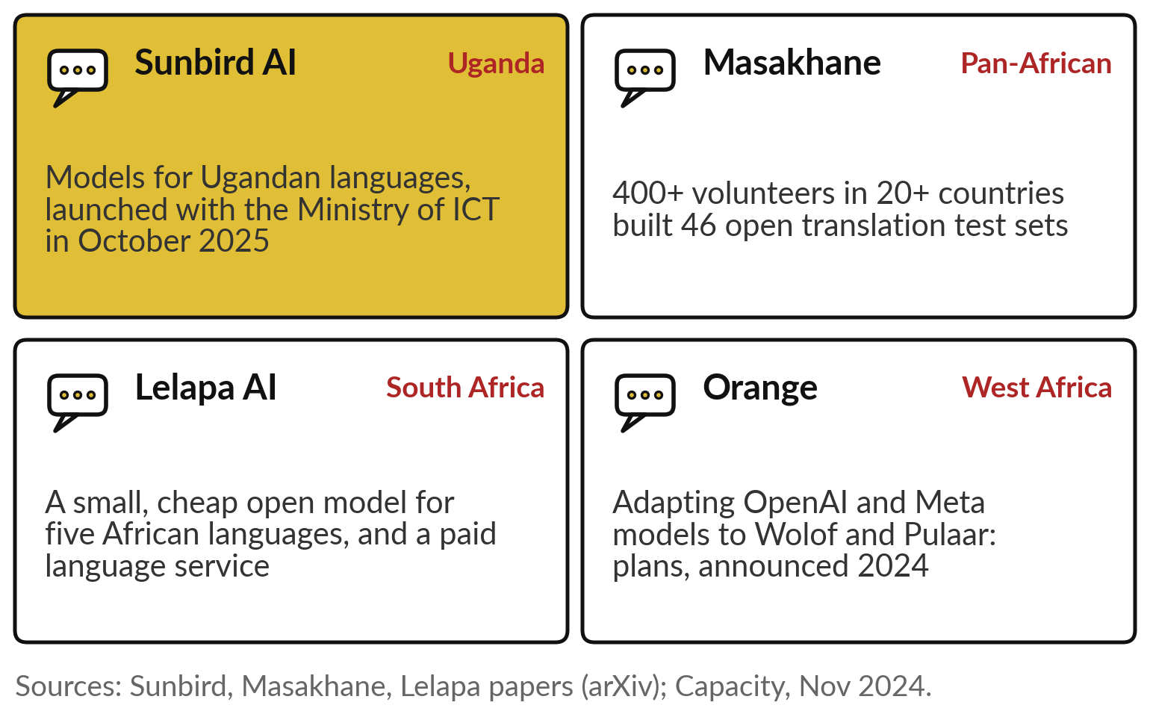
Africans are building for African languages:
Sunbird, Masakhane, Lelapa and Orange
Four efforts to fill the shelf, from Kampala to Dakar.
Sunbird: Ugandan languages.
Masakhane: volunteers and open data.
Lelapa and Orange: business services, plans.
Notes:
Four efforts are worth knowing. Sunbird AI, here in Uganda, built models for Ugandan languages and launched them with the Ministry of ICT in October 2025; its story follows in the tour. Masakhane is a volunteer community: more than 400 people in at least 20 countries built 46 open translation test sets for their own languages, so the speakers of a language help build its AI.
Lelapa AI in South Africa made a deliberately small, cheap open model, open meaning anyone may download and run it, as Session 6 explains, for five African languages, and sells a language service to businesses. And Orange announced in 2024 that it is adapting OpenAI and Meta models to Wolof and Pulaar for customer service; those are plans. Now the fourth job.

Slide 16
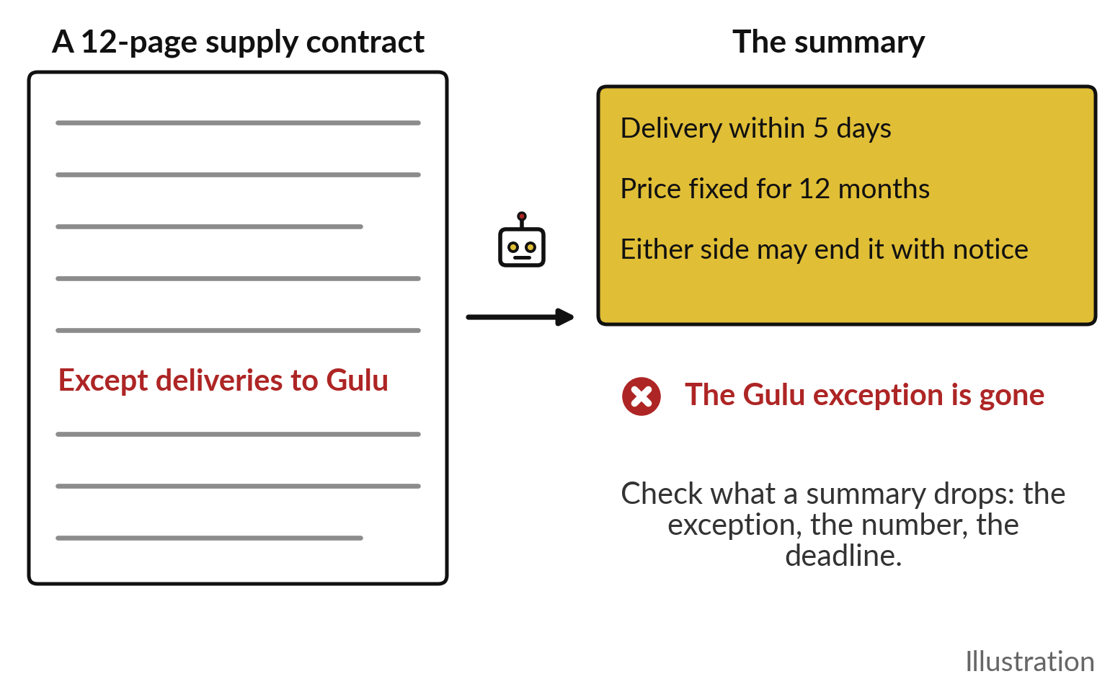
Summarising saves reading time, and
can drop the one sentence that matters
A summary is a draft. Check what it left out.
Fifty pages to one, in seconds.
It may drop an exception or a number.
Read the original for anything you act on.
Notes:
The fourth job is summarising, and it is the one leaders feel first. A twelve-page supply contract becomes three lines in seconds: delivery within five days, price fixed for twelve months, either side may end it with notice. That saves real time. But look at the red words on the left.
Halfway down, the contract says, except deliveries to Gulu. The summary has dropped it. This picture is an illustration, and the risk is real: a summary keeps what looks typical and can lose the exception, the number or the deadline. Treat a summary as a draft, and read the original for anything you act on. So, the balance sheet.

Slide 17
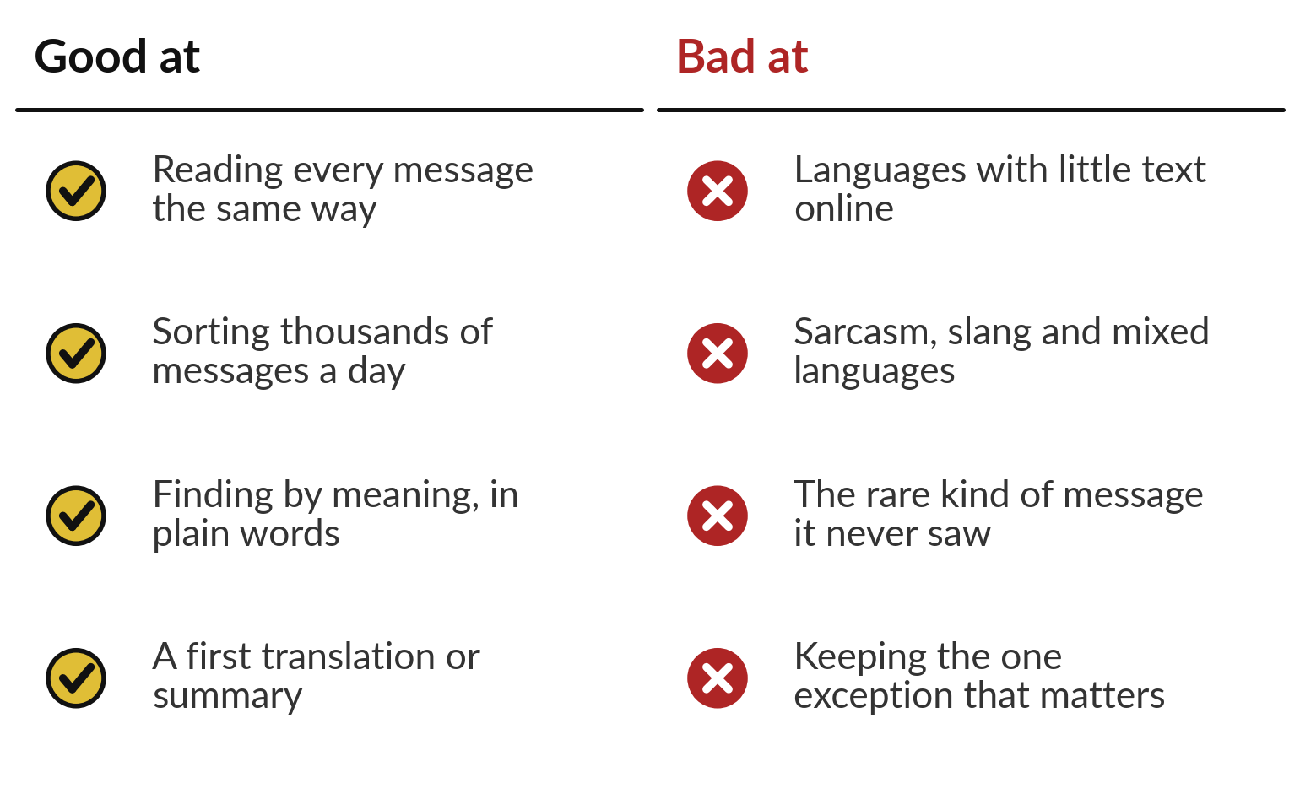
Language AI is good at volume and finding by
meaning, and weak on rare cases and our languages
Use it for volume and first drafts. Keep people on the rare and the risky.
Strong: volume, consistency, plain-word search.
Weak: our languages, the unusual, the exception.
Notes:
Put together, the pictures show where language AI earns its place. It is good at volume: it reads every message the same way, sorts thousands a day, finds a passage from a plain description, and gives you a first translation or summary in seconds. It is weak where its library is thin: languages with little text online, sarcasm, slang and messages that mix English and Luganda in one line, the rare kind of message it never saw, and the single exception buried in page nine.
So use it for volume and first drafts, and keep people on the rare and the risky. Where are organisations like yours already using it?

Slide 18
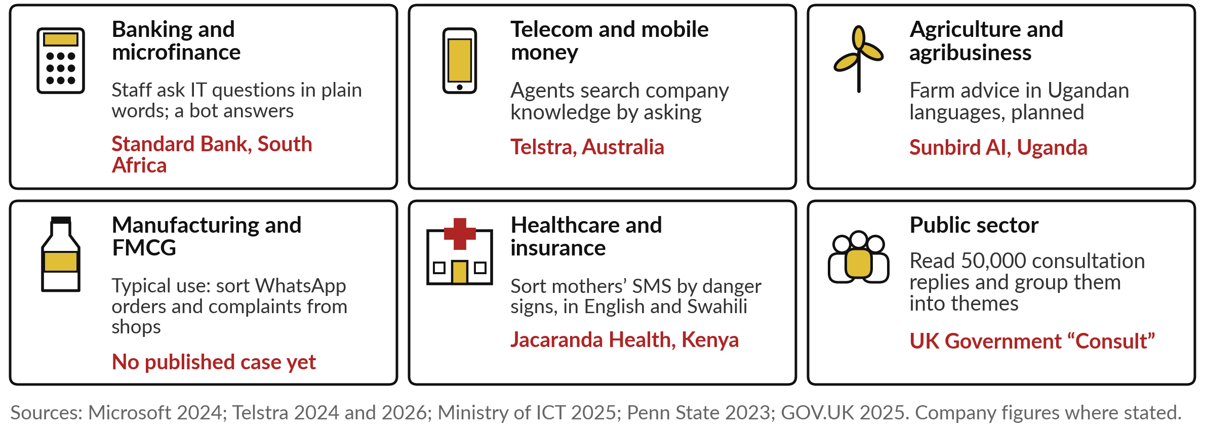
Language AI at work in six industries, with
a named example where one is published
Three follow as stories: the UK government’s Consult, Telstra and Sunbird AI.
Notes:
Here are the four jobs in the six main industries. In banking, Standard Bank’s staff ask a bot their IT questions in plain words. In telecom, Telstra’s agents search company knowledge by asking, and see a customer’s history in one sentence. In agriculture, Uganda plans to send farmers advice in their own languages through Sunbird’s models.
In FMCG we have no published case yet; the typical use is sorting the orders and complaints shops send by WhatsApp, which is our fictional Nile Valley Foods example later today. In health, Jacaranda Health, which you met in Session 2, sorts mothers’ text messages in English and Swahili by danger signs.
And in the public sector, the UK government reads consultation replies with AI. Find your tile. Three stories follow.

Slide 19
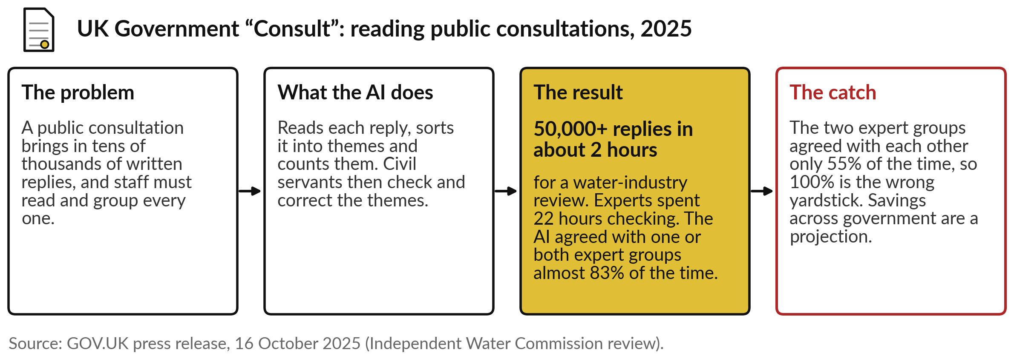
UK government “Consult”: 50,000 public replies
sorted into themes in about two hours, then checked
Sort and summarise at scale, with people checking the themes.
Notes:
The first story is sorting and summarising at scale. A public consultation brings in tens of thousands of written replies, and civil servants must read and group every one. The UK government’s tool, called Consult, reads each reply, sorts it into themes and counts them; staff then check and correct the themes.
For a review of the water industry, it sorted more than 50,000 replies in about two hours, and experts spent 22 hours checking. It agreed with one or both of two expert groups almost 83 per cent of the time. The catch teaches Session 3 again: the two expert groups agreed with each other only 55 per cent of the time. Compare a machine with people, never with perfection.

Slide 20
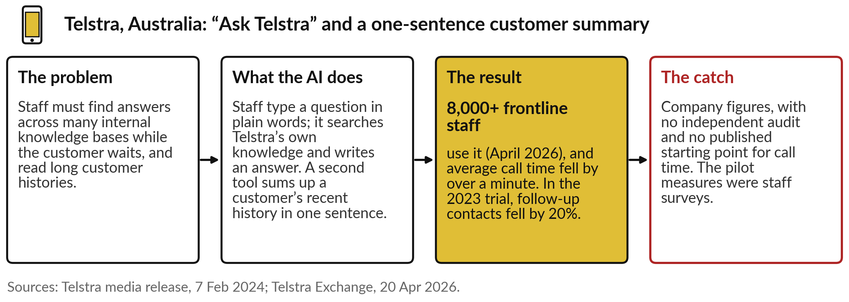
Telstra: frontline staff ask the company’s
knowledge in plain words, and calls got shorter
Search by meaning and summary, inside a contact centre.
Notes:
The second story is search by meaning inside a contact centre. Telstra’s frontline staff had to find answers across many internal knowledge bases while the customer waited, and read long customer histories. Now they type a question in plain words, and Ask Telstra searches the company’s own knowledge and writes an answer.
A second tool sums up a customer’s recent history in one sentence. By April 2026 more than 8,000 frontline staff used it, and Telstra says average call time fell by over a minute; in the 2023 trial, follow-up contacts fell by 20 per cent. The catch: these are company figures, with no independent audit, and the pilot measures were staff surveys.

Slide 21
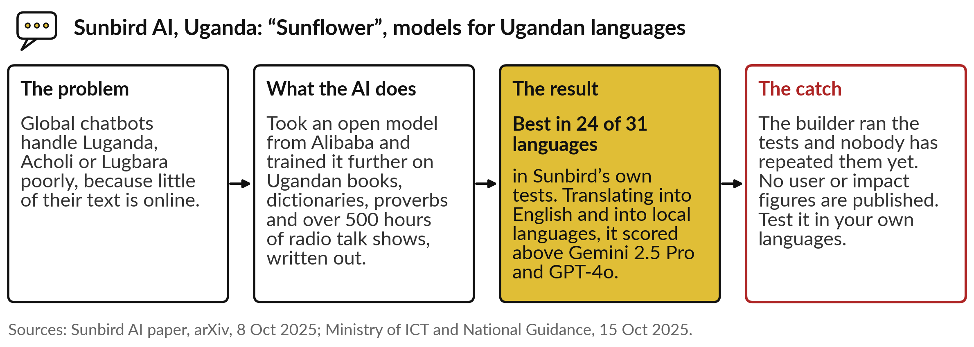
Sunbird AI, Kampala: models for Ugandan languages,
best in its own tests, not yet tested by others
Building the shelf for our own languages.
Notes:
The third story is ours. Global chatbots handle Luganda, Acholi or Lugbara poorly, because so little of their text is online. Sunbird AI in Kampala took an open model from the Chinese company Alibaba and trained it further on Ugandan books, dictionaries and proverbs, and on more than 500 hours of radio talk shows written out as text.
In Sunbird’s own tests the paper claims the best results in 24 of 31 languages, and in translation into English and into local languages it scored above two leading global models. The catch: the builder ran the tests, nobody has repeated them, and no user figures exist yet. That is exactly why we test.

Slide 22
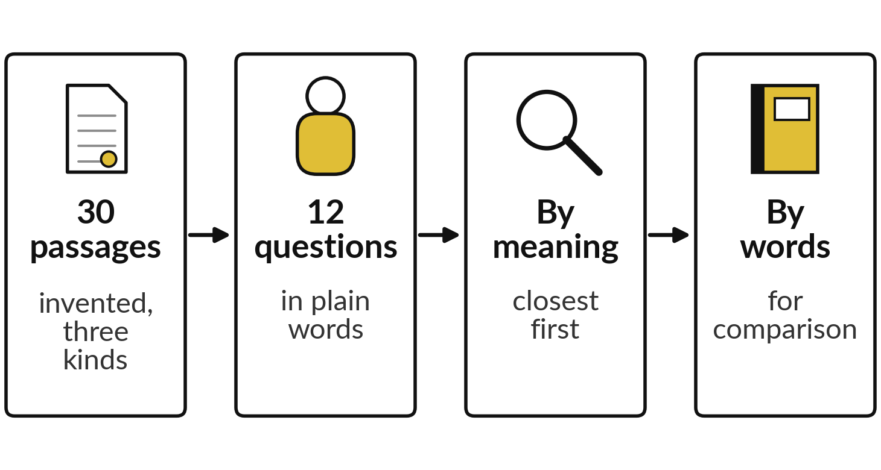
Demonstration: describe a passage in plain words,
and see whether search by meaning finds it
I will show
Watch for
Does the right passage come first, or in the top three?
What word search finds for the same question
Where it slips, and who chooses
Notes:
Now you see search by meaning at work, in recorded runs. I wrote thirty short invented passages for Nile Valley Foods: ten contract clauses, ten finance terms and ten paragraphs of an HR policy. Then I wrote twelve questions the way a manager or an employee would ask them, and noted the right passage for each before running anything.
A free model, all-MiniLM-L6-v2, did the search by meaning, and a word search ran alongside for comparison. These were recorded on 6 November 2026. Watch for three things: whether the right passage comes first or in the top three, what word search finds, and where it slips.

Slide 23
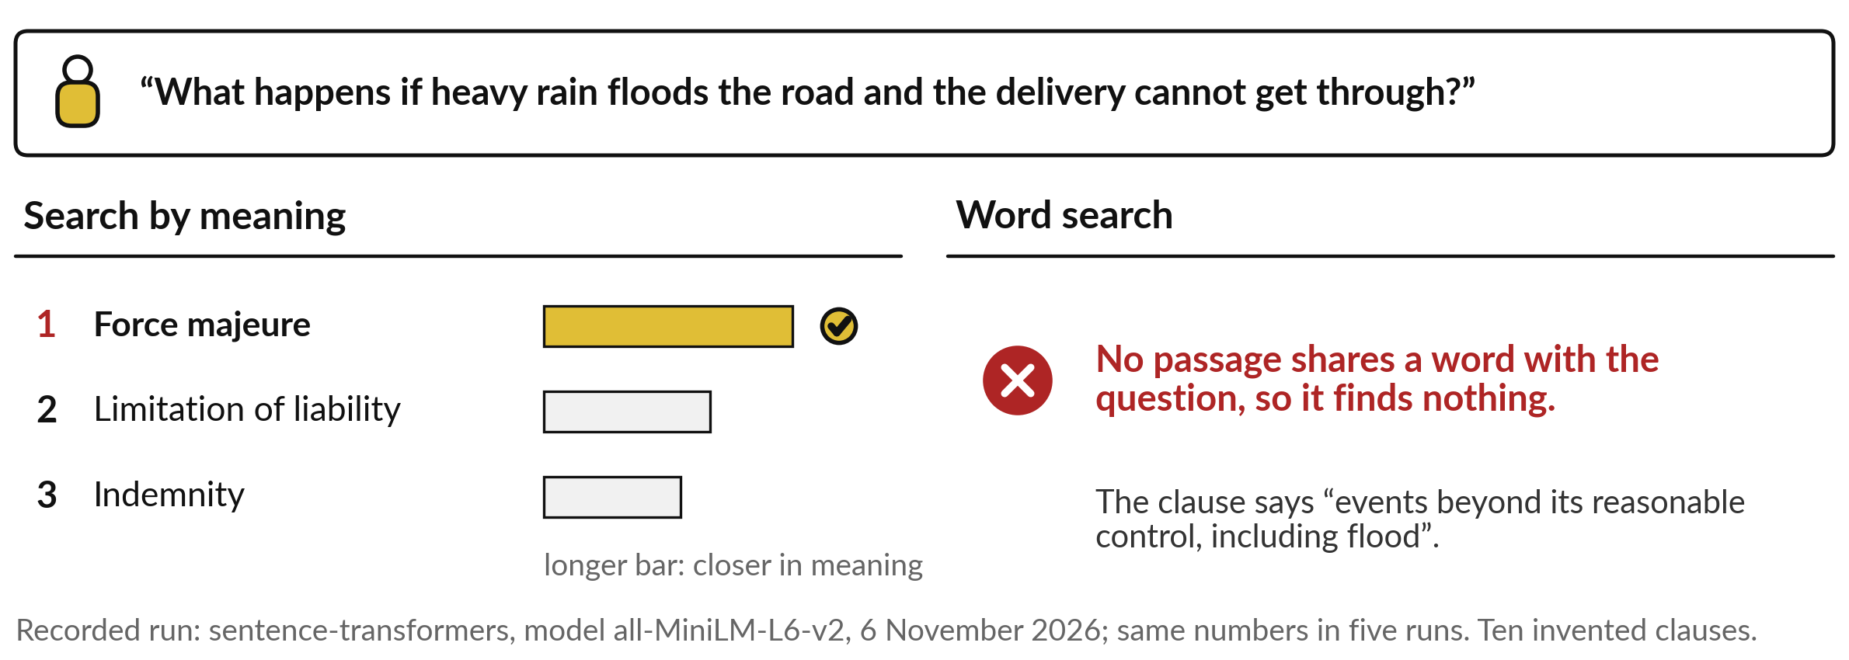
The flood question: search by meaning puts
force majeure first; word search finds nothing
The right clause first, with no word in common.
Notes:
Here is the flood question from earlier, run for real. Search by meaning puts force majeure first, then limitation of liability, then indemnity. The bars show how close each clause sat to the question: force majeure is clearly ahead. On the right, word search finds nothing at all, because no clause shares a word with the question.
That is the whole point of the map. A manager who has never heard the words force majeure can still find the clause by describing the problem. Contracts were the easy case, though: all four contract questions found the right clause first. Policies and finance terms were harder.

Slide 24
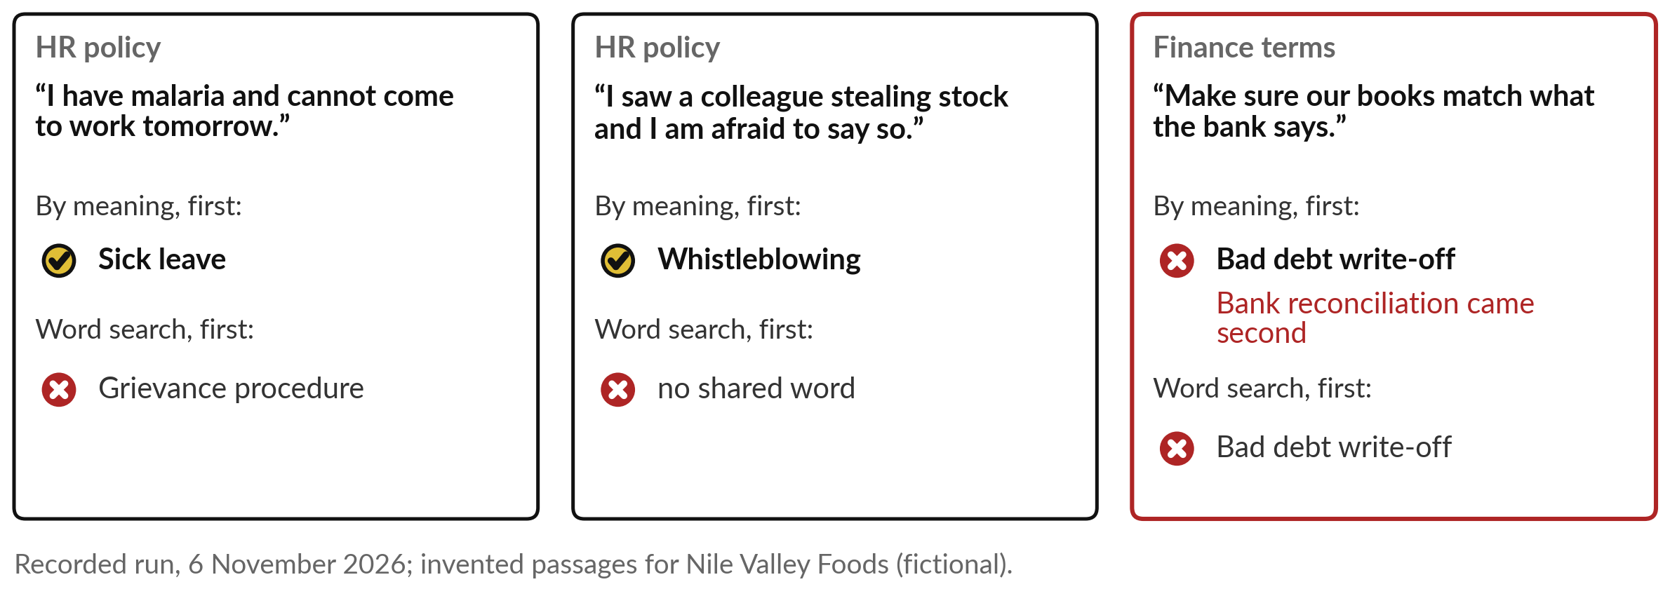
Two more wins and one slip: malaria finds sick leave,
theft finds whistleblowing, the bank comes second
Show the top three, and let a person choose.
Notes:
Here are three more. An employee writes: I have malaria and cannot come to work tomorrow. Search by meaning finds the sick leave paragraph first, while word search offers the grievance procedure. Another writes: I saw a colleague stealing stock and I am afraid to say so. Meaning finds whistleblowing; word search finds nothing in common.
Now the slip, in red. A finance officer asks: make sure our books match what the bank says. Meaning put bad debt write-off first and the right answer, bank reconciliation, second. A person who sees the top three picks it at once. So how did it do across all twelve?

Slide 25
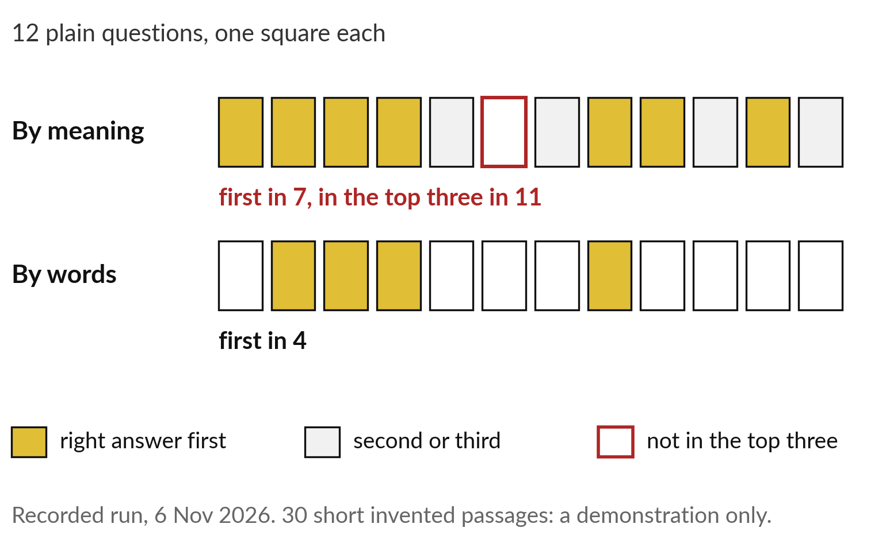
Across 12 plain questions the right passage came first
7 times and in the top three 11 times; word search, 4
Good enough to shortlist. A person still decides.
By meaning: first in 7, top three in 11.
By words: first in 4.
Twelve questions: a demonstration only.
Notes:
Here is the tally, one square per question. Search by meaning put the right passage first in 7 of the 12 and in the top three in 11. Only one, a question about a shop returning damaged bags, missed the top three. Word search put the right passage first in 4.
So the lesson for a leader is about design: show staff the top three with their sources, and let a person choose. And treat these twelve questions on thirty short passages as a demonstration only; it is too small to be a benchmark. Your own documents, in your own languages, need their own test. That brings us to the job we cannot record in advance.

Slide 26
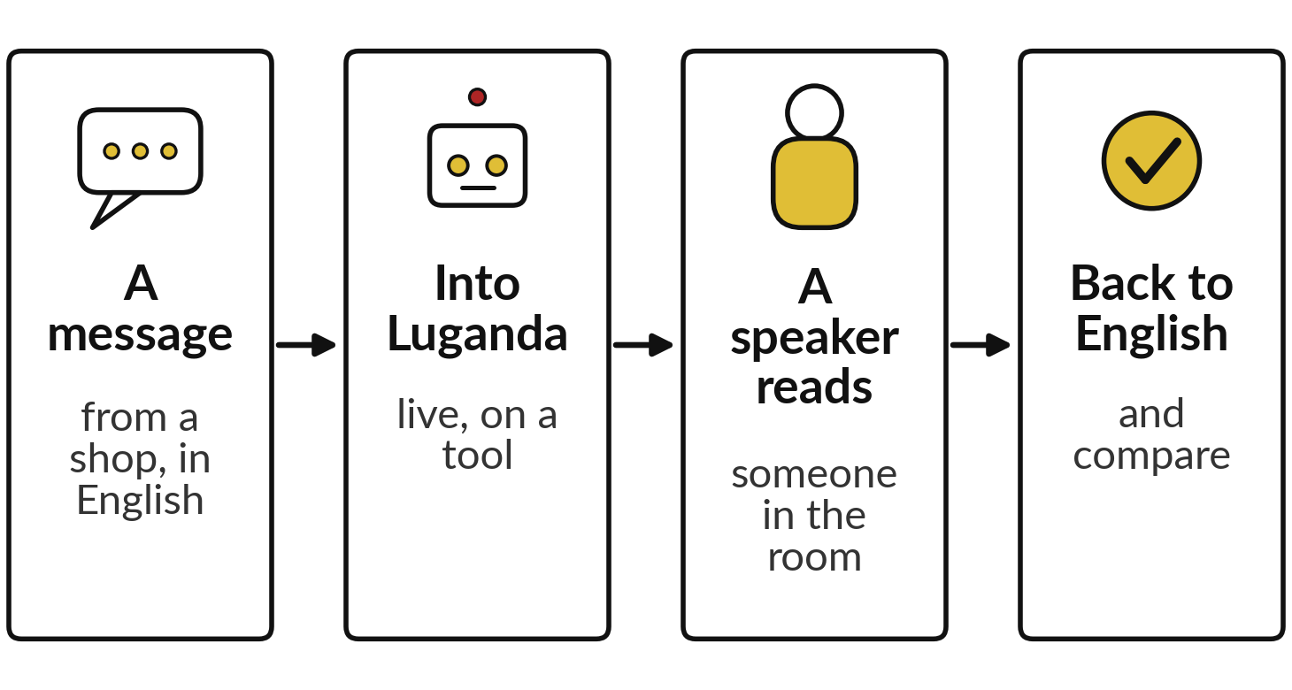
Live demonstration, with a fallback: one
customer message into Luganda and back
I will show
Watch for
Is the meaning kept?
Do names, amounts and dates survive?
What a Luganda speaker in the room says
If it fails: speakers translate by hand
Notes:
This one is live, so neither of us knows the result. I take a short message from a shop, such as: the maize flour was late and the invoice is wrong. I ask a translation tool to put it into Luganda, and I ask a Luganda speaker in the room to read it aloud and tell us whether it sounds right.
Then I translate it back into English and we compare. Watch whether the meaning survives, and whether names, amounts and dates come through intact. If the connection fails, we use Sunbird’s published test results instead, and our Luganda speakers translate by hand. Whatever happens, it is one message, too few to judge a tool.

Slide 27
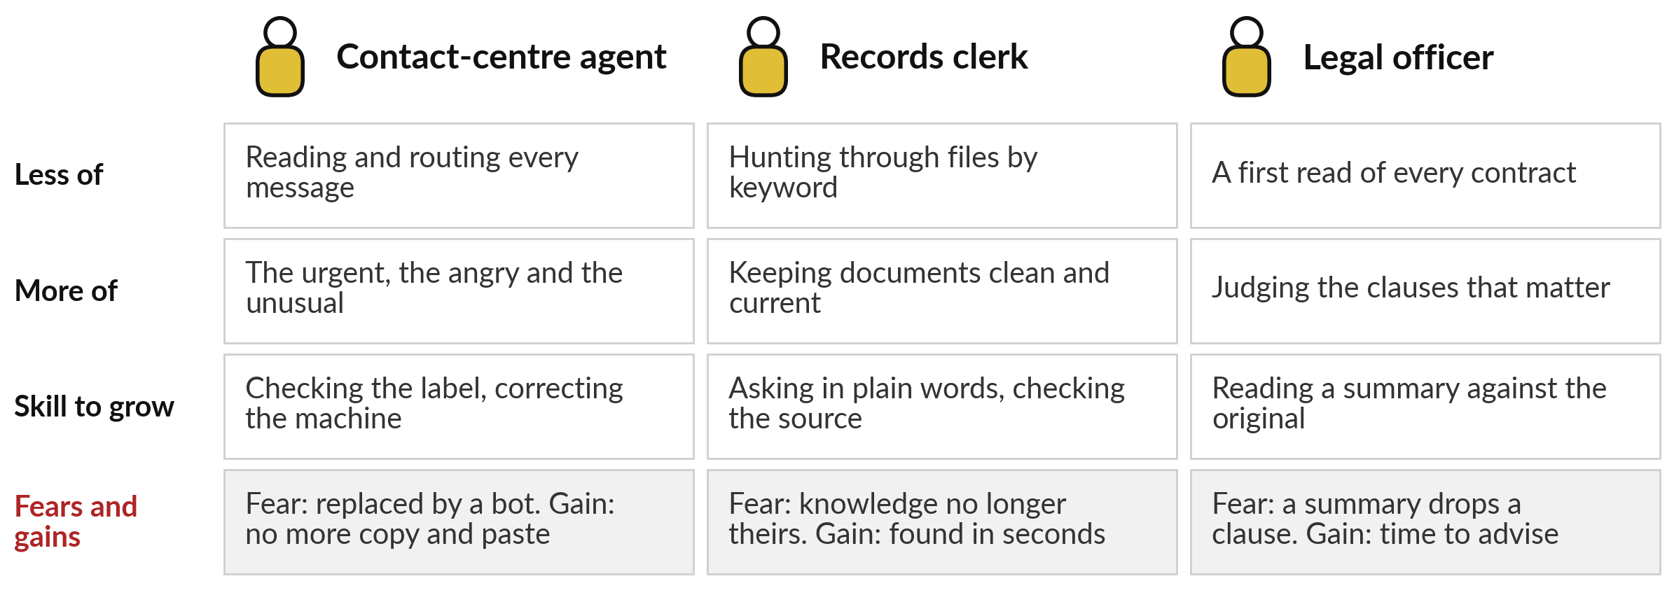
Your people: agents, records staff and legal
officers read less, and judge and correct more
Jacaranda’s help desk answers the urgent messages first; Telstra’s agents ask instead of hunting.
Notes:
We turn to your people, because language AI changes their day before it changes your results. A contact-centre agent stops reading and routing every message and spends the time on the urgent, the angry and the unusual. The skill to grow is checking the label and correcting the machine.
A records clerk stops hunting through files and becomes the keeper of clean, current documents, because search is only as good as what it searches. A legal officer stops first-reading every contract and judges the clauses that matter, reading summaries against the original. The fears are real: replaced, sidelined, a dropped clause.
What do your agents or clerks fear today?

Slide 28
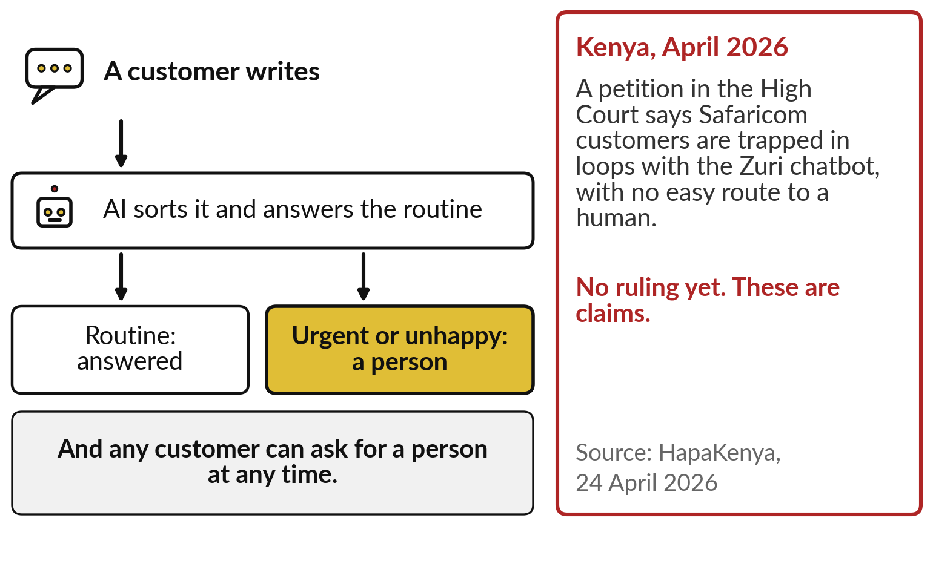
Always leave a door to a person: a Kenyan petition
says customers were trapped with a chatbot
Sort and answer the routine. Route the rest to a person, fast.
Urgent or unhappy: straight to a person.
A visible way to ask for a human.
Name who owns the routing rules.
Notes:
Whatever your people fear, your customers fear one thing: being stuck with a machine. Design for it. AI sorts each message and answers the routine. The urgent and the unhappy go straight to a person. And any customer can ask for a person at any time, by a route they can see.
In Kenya in April 2026, a petition in the High Court claimed that Safaricom customers are trapped in loops with its Zuri chatbot with no easy way to reach a human. These are claims, with no ruling yet. The lesson stands: a named manager owns the routing rules, and checks every month who waited and why.

Slide 29






Questions to ask your team and your
vendor before you trust a language tool
Ask | Why it matters
Which languages does it handle, and was it tested on ours? | Quality falls where a language has little text
How often is it right on our own messages, ones it never saw? | The vendor’s demo text is cleaner than yours
Does it show the top few results and the source passage? | A person can then choose and check
How does it handle slang, spelling slips and mixed languages? | Customers write the way they speak
Where do our messages and documents go, and who can read them? | Contracts and complaints hold personal data
How does a customer reach a person, and how fast? | Loops with no exit lose customers
Notes:
Everything so far comes down to six questions. Ask which languages the tool handles, and whether it was tested on ours, because quality falls where a language has little text. Ask how often it is right on your own messages, ones it never saw, as in Session 3, since the vendor’s demonstration text is always cleaner than yours.
Ask whether it shows the top few results and the source, so a person can choose. Ask how it handles slang, spelling slips and English and Luganda in one sentence. Ask where your messages and documents go; Session 6 returns to that. And ask how a customer reaches a person. Now we turn these on your own organisation.

Slide 30
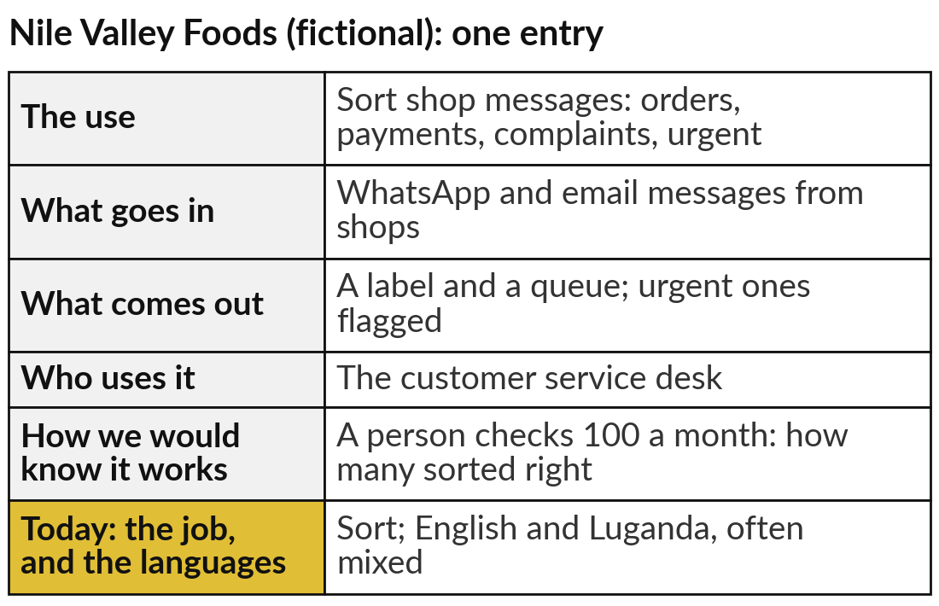
Add one or two piles of your own
text to your AI Opportunity Portfolio
25 minutes
Hands-on: your portfolio
Find a pile of text your organisation struggles to read, and give it a job.
Name the pile: messages, contracts, reports or calls.
Fill the five columns, as in the example.
Add today’s column: the job, and the languages.
Write how a person checks the output.
You keep: One or two portfolio entries, each with its job, its languages and its check.
Notes:
For twenty-five minutes you work on your own organisation, and I walk round. Think of a pile of text your organisation struggles to read: customer messages, contracts, complaints, reports, minutes, recorded calls. Open the AI Opportunity Portfolio in your workbook and fill the five columns: the use, what goes in, what comes out, who uses it, and how you would know it works.
Then today’s column: which of the four jobs, sort, search, translate or summarise, and in which languages. The example on the right is for Nile Valley Foods, our fictional distributor. Finish by writing how a person would check the output each month.

Slide 31




Which language job would pay
off first in your organisation?
Of the piles of text you just wrote down, which job would you start with, and why?
Sort the inbox
Search our documents
Translate or summarise
Not yet
Messages and complaints labelled and routed, urgent ones first
Staff find the policy or clause by asking in plain words
Reach customers in their language; read long reports faster
Our documents are scattered, out of date or on paper
Write your decision and the reason in your workbook.
Notes:
With your entries written, one decision. Which job would pay off first?
Sort the inbox, if messages and complaints pile up and the urgent ones wait too long. Search our documents, if staff waste time hunting for the right policy, product sheet or clause. Translate or summarise, if you need to reach customers in their own language or your managers drown in long reports.
Or not yet, if your documents are scattered, out of date or still on paper. That is a useful answer too, because your first project is then putting the documents in order, which Session 14 covers. Tell me your choice and the pile it works on.

Slide 32
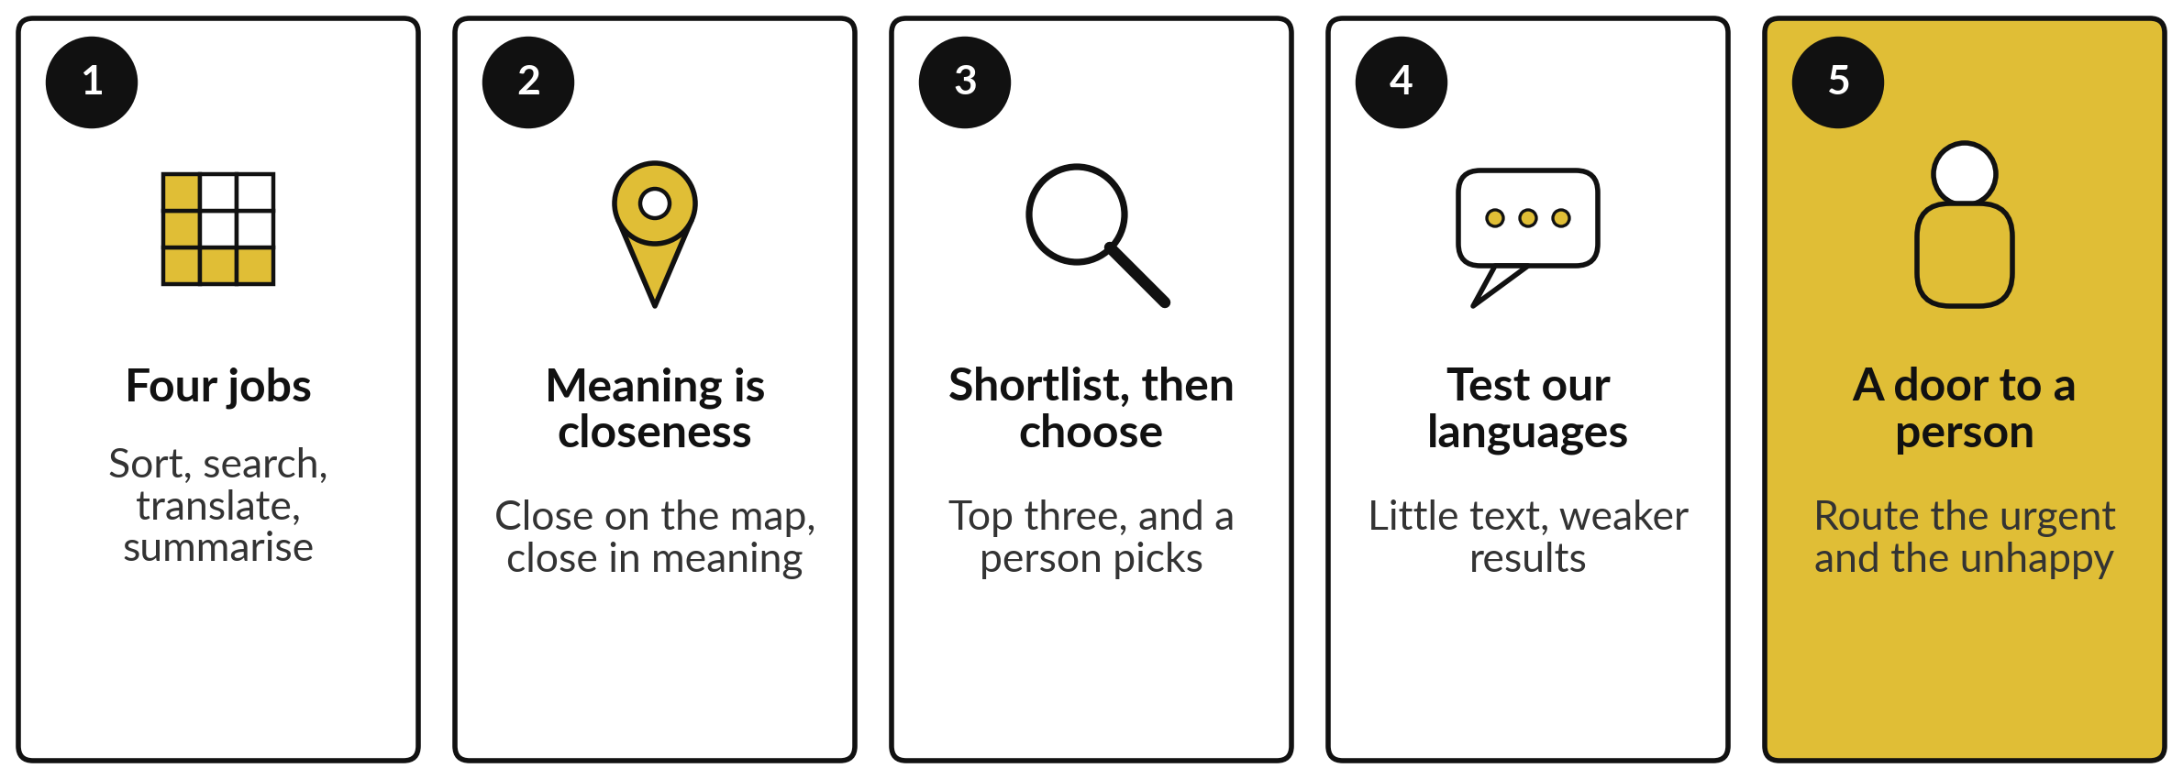
Take-away: five things to remember
Notes:
Here is the session in five lines. AI does four jobs with language: it sorts, searches by meaning, translates and summarises. It sees meaning as closeness on a map, so a plain question finds the right clause even with no word in common. Its results are a shortlist: in our recorded run the right passage came first for 7 of 12 questions and in the top three for 11, so show the top three and let a person choose.
Our languages have less text behind them, so test them with native speakers. And always leave customers a door to a person. Now, what you take away.

Slide 33
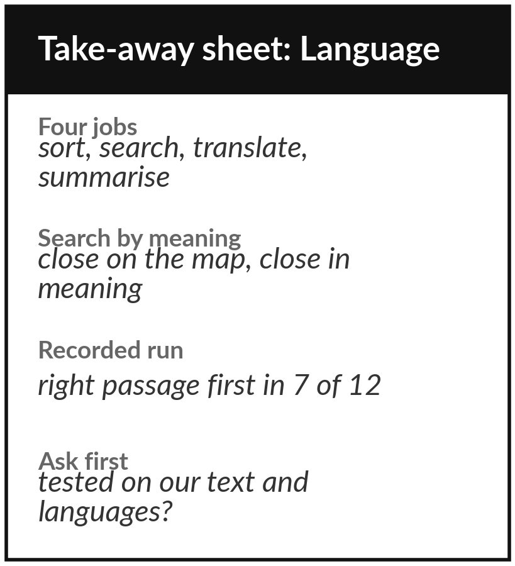
Keep the sheet, and the pile of
text you added to your portfolio
What you keep from today
A one-page sheet: the four language jobs, the map of meaning, today’s recorded search results, the questions to ask, and your new portfolio entries.
Our question today
What can AI do with our messages, contracts and calls, in English and in our local languages?
Next session
Session 5: Generative AI: how chatbots write, and why they sometimes invent.
Notes:
Keep the take-away sheet. It has the four language jobs, the picture of meaning as closeness on a map, today’s recorded numbers, the right passage first for 7 of 12 plain questions and in the top three for 11, against 4 first for word search, and the six questions to ask.
Your portfolio now holds a pile of text and the job you would give it. In Session 5 we turn from AI that reads and finds to AI that writes, and ask why a chatbot can sound so sure and still be wrong.
We began with this question: What can AI do with our messages, contracts and calls, in English and in our local languages? Before you go, say in one sentence what you can now say about it.

